Slide 1



Slide 2

Lecture 2

Slide 3
formulas
Microsoft Excel is a popular tool for managing data and performing data analysis. It is used for generating analytical reports, business insights, and storing operational records. To perform simple calculations or analyses on data, we need Excel formulas.
Even simple Excel formulas allow us to manipulate string, number, and date data fields. Furthermore, you can use if-else statements, find and replace, mathematics and trigonometry, finance, logical, and engineering formulas.
Unlike programming languages, you will be writing the formula name and arguments. That’s it, nothing complex. You can also use Excel-assisted user interference to add formulas

Slide 4

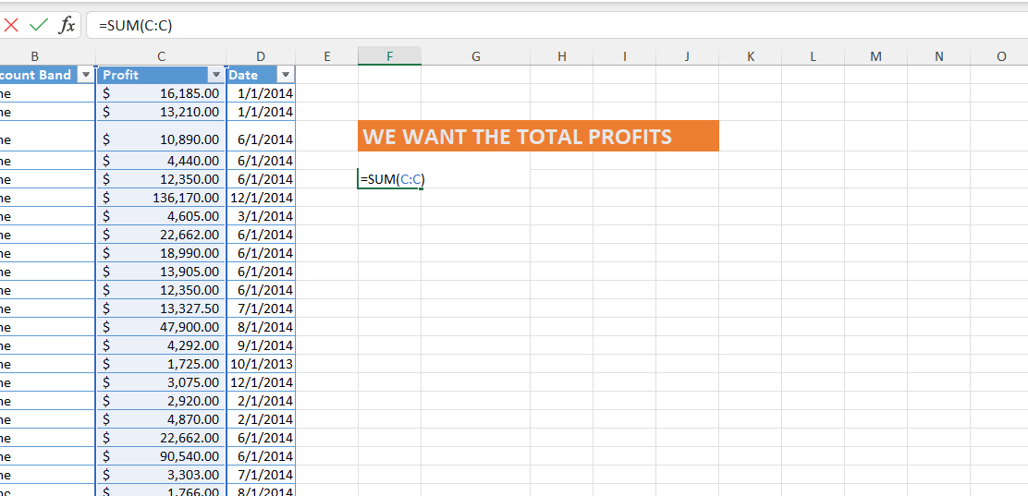
SUM

Slide 5
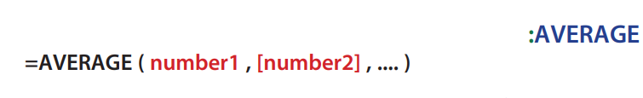
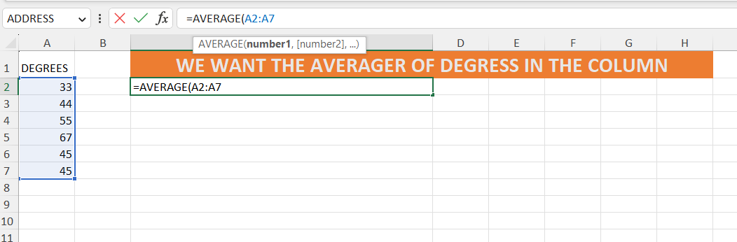
AVERAGE

Slide 6


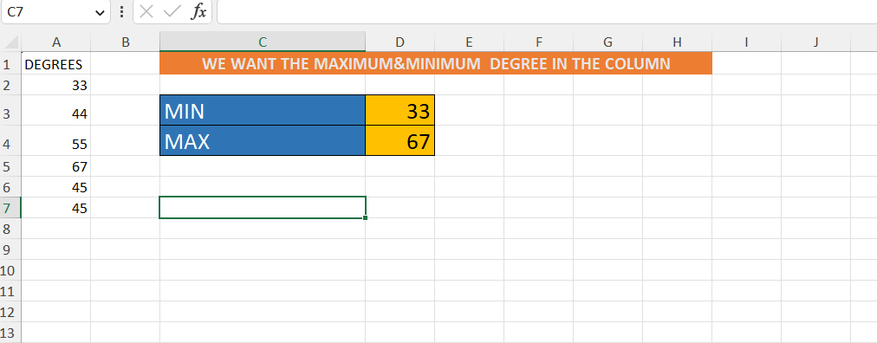
MAX &MIN

Slide 7


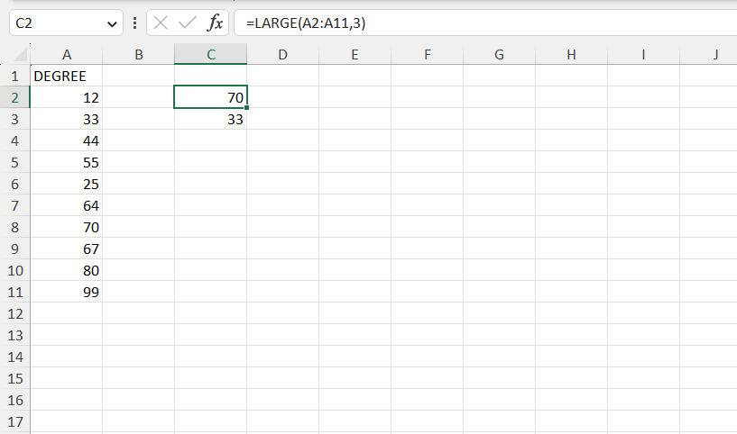
LARGE &SMALL

Slide 8
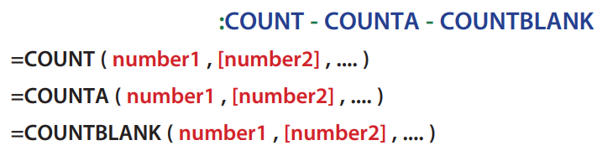
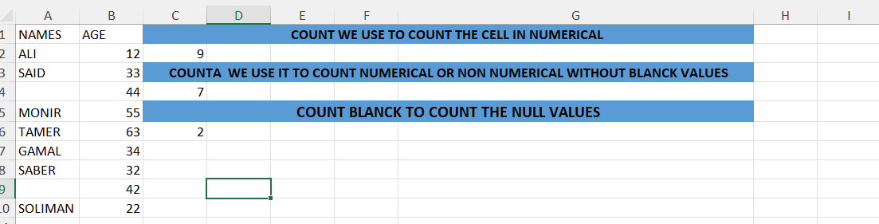
COUNT&COUNTA&COUNTBLACK

Slide 9
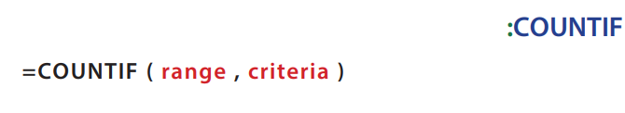
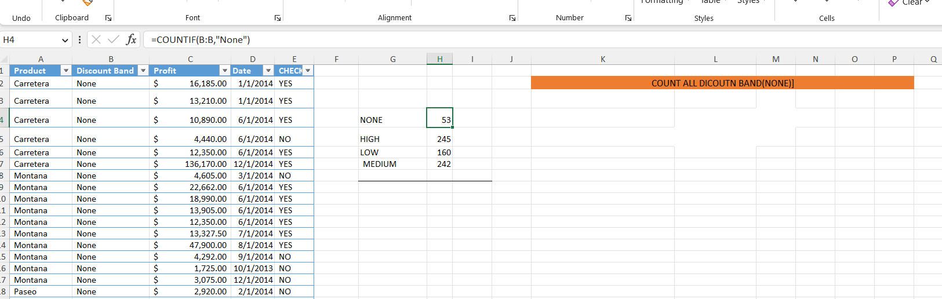
COUNTA

Slide 10
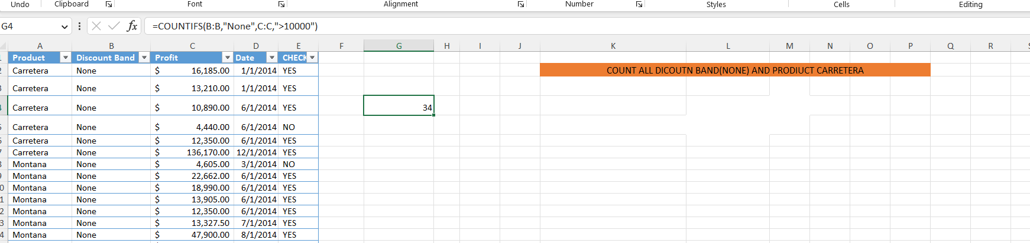
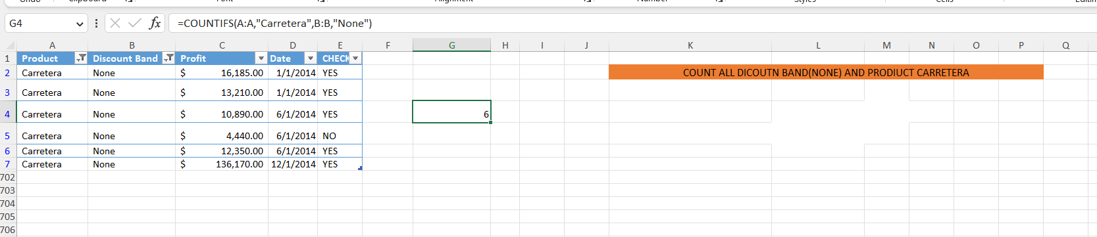
COUNTIFS

Slide 11

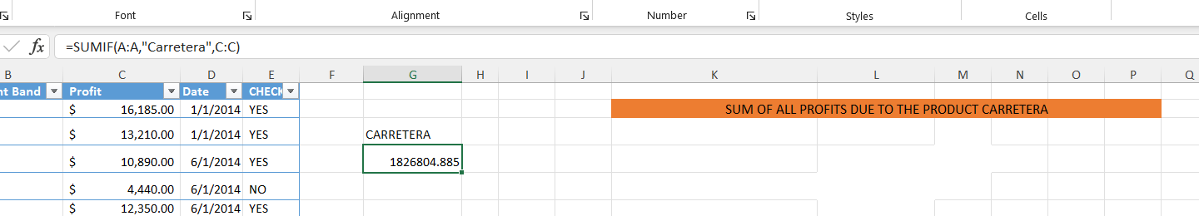
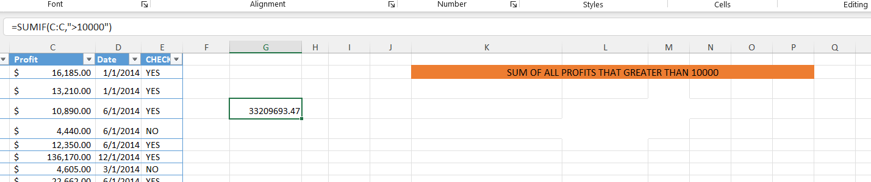
SUMIF

Slide 12
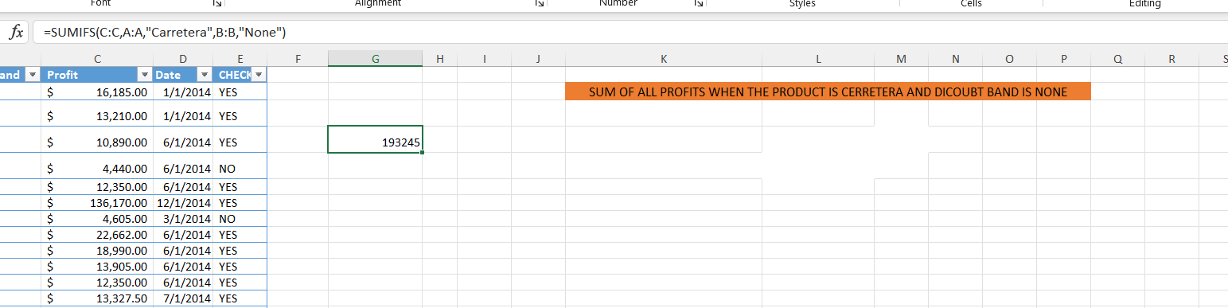
SUMIFS

Slide 13

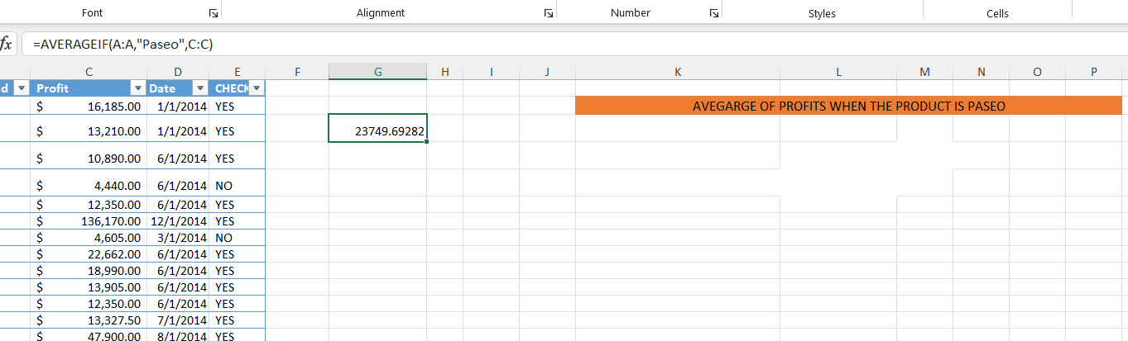
AVERAGEIF

Slide 14

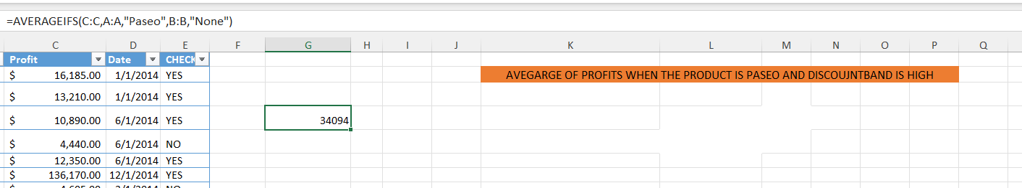
AVERAGEIFS

Slide 15
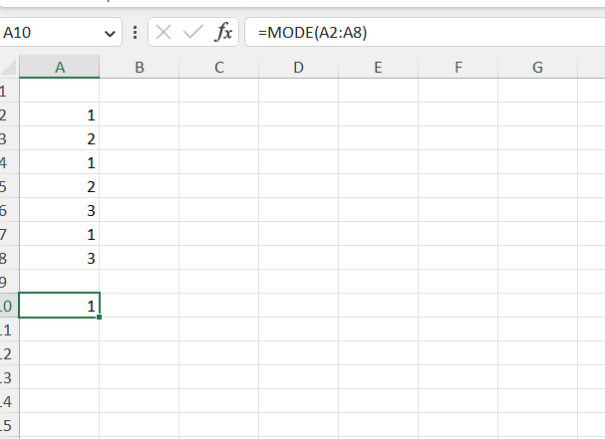
MODE

Slide 16

Data visualization
Data visualization is the graphical representation of information and data. By using visual elements like charts, graphs, and maps, data visualization tools provide an accessible way to see and understand trends, outliers, and patterns in data. Additionally, it provides an excellent way for employees or business owners to present data to non-technical audiences without confusion.
In the world of Big Data, data visualization tools and technologies are essential to analyze massive amounts of information and make data-driven decision

Slide 17
Lets start with data visualization
How can we make an chart that defining the data
We will go to
Select the data ➔ insert ➔we choose the best chart for the data

Slide 18
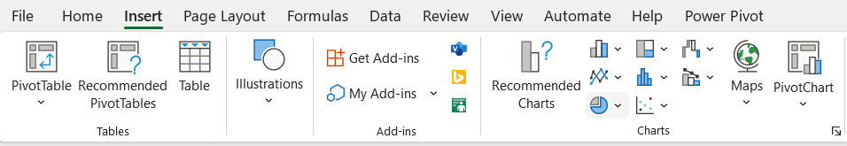
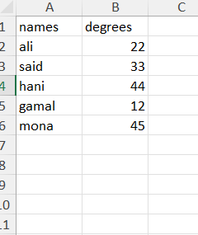
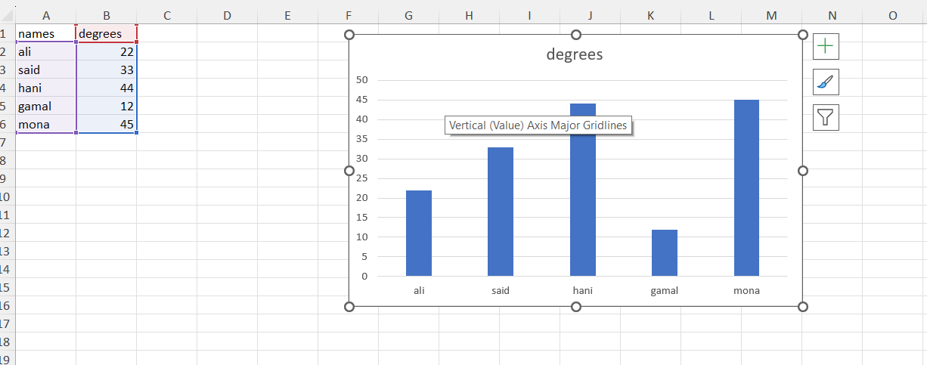
If you have this simple data

Slide 19
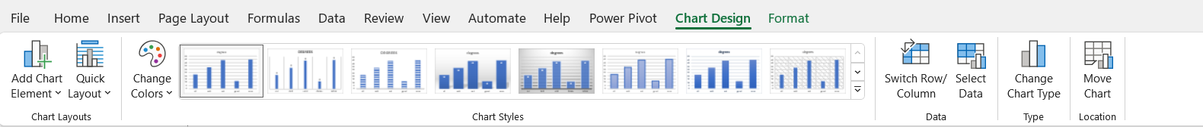
Look what’s happen there are two options opened 1-format 2-design

Slide 20

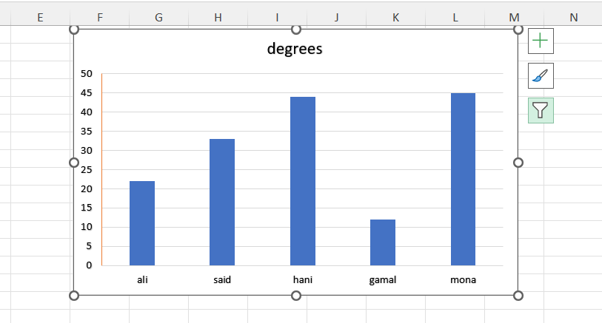
look

Slide 21
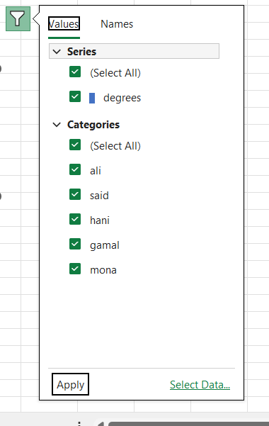
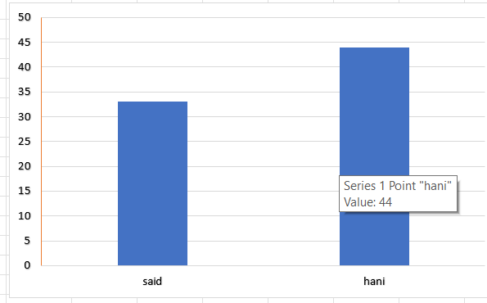
Filter

Slide 22
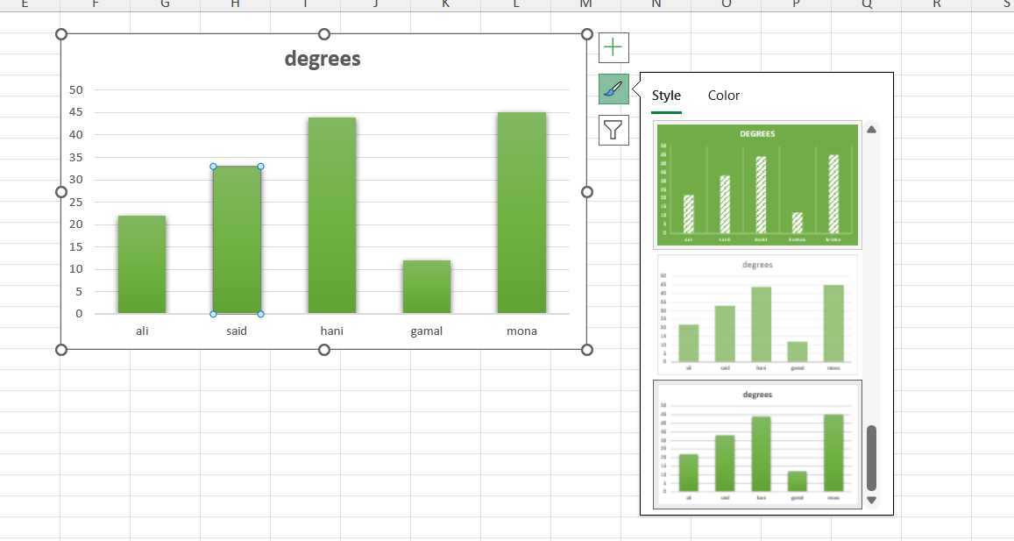
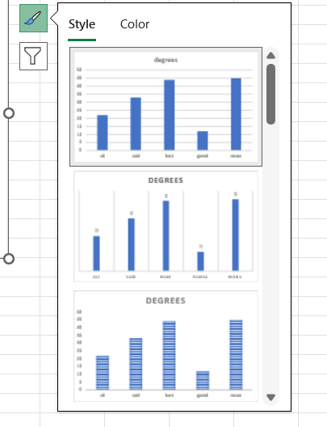
style

Slide 23
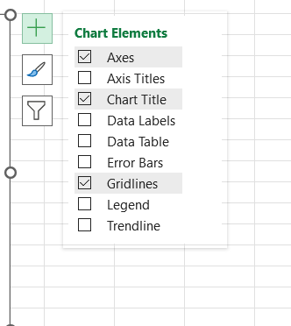
Chart elements

Slide 24
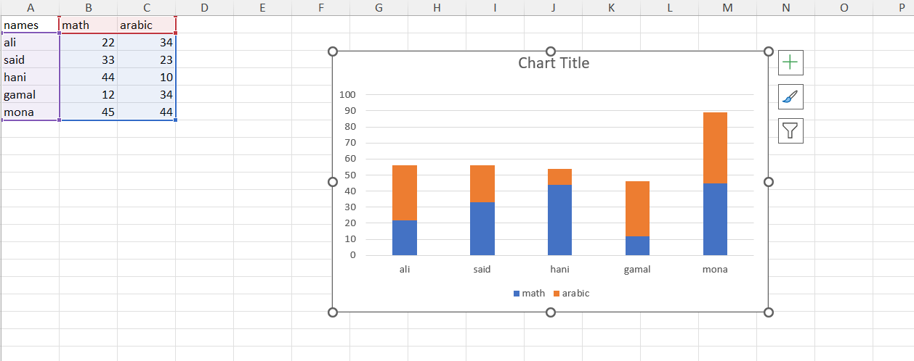
Stacked bar chart

Slide 25
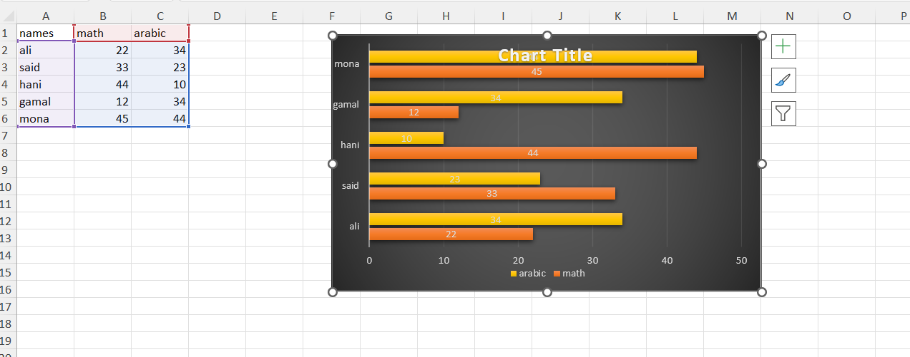
Cluster bar chart

Slide 26
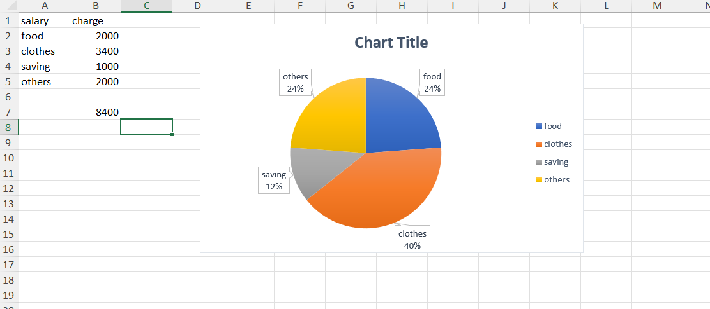
Pie chart

Slide 27
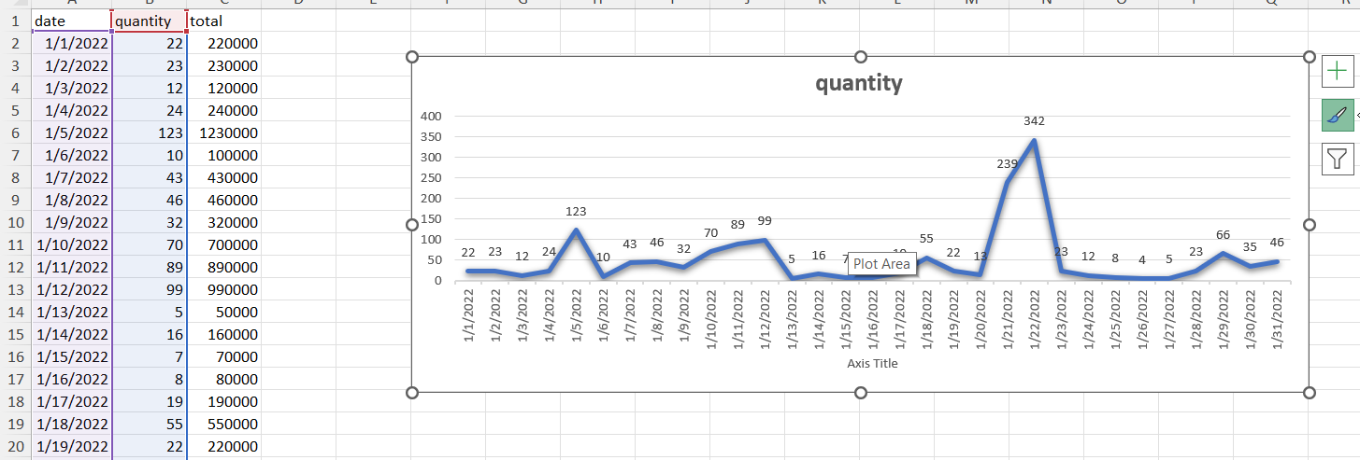
Line chart
Line charts are typically used for showing trends over time.

Slide 28
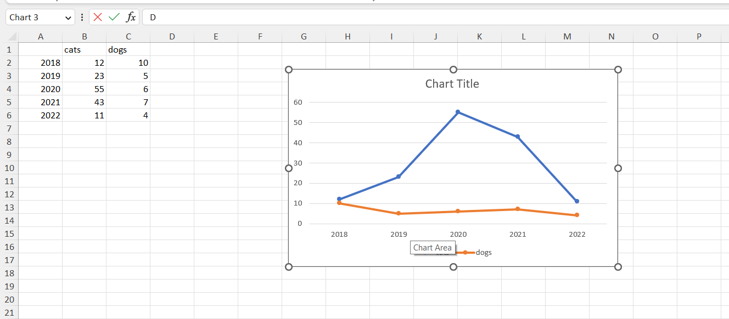
Multiple line chart

Slide 29
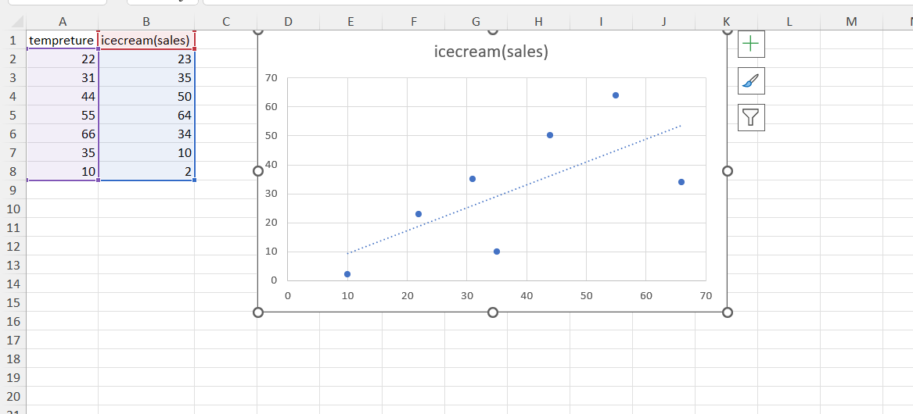
Scatter plot

Slide 30

histogram
What Is a Histogram?
A histogram is a graphical representation of data points organized into user-specified ranges. Similar in appearance to a bar graph, the histogram condenses a data series into an easily interpreted visual by taking many data points and grouping them into logical ranges or bins

Slide 31
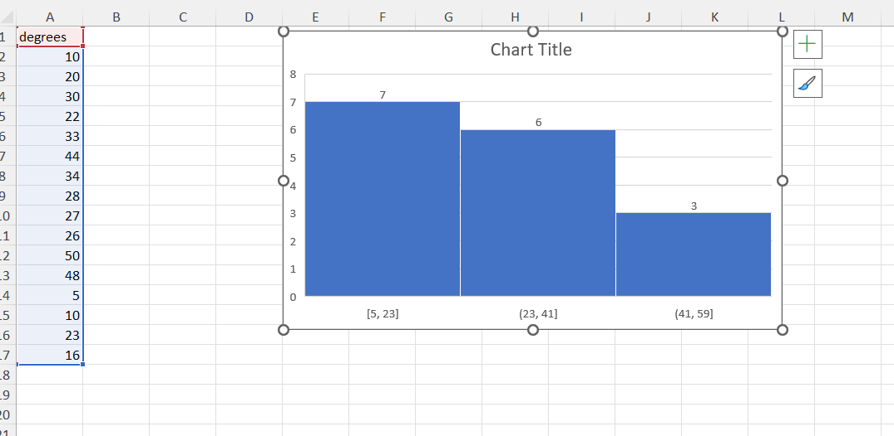
look

Slide 32
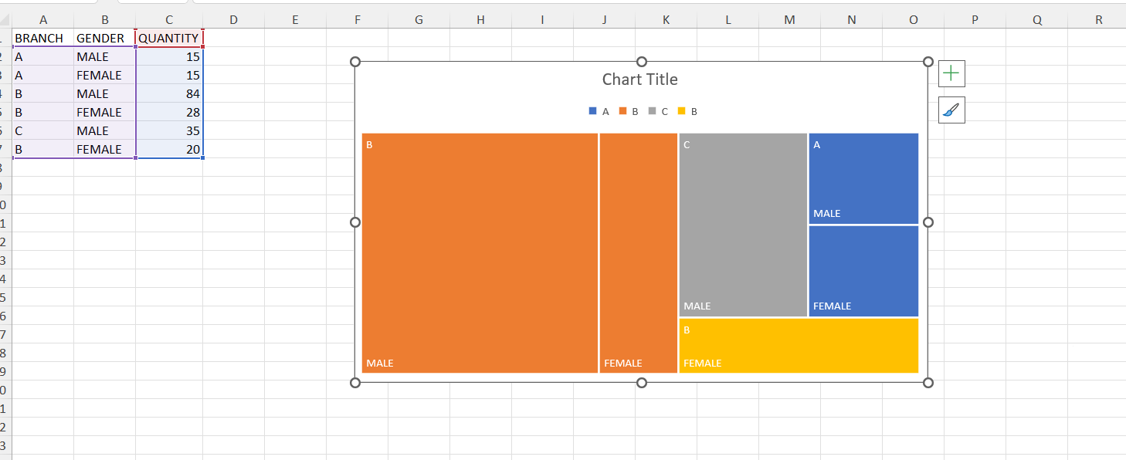
Tree map

Slide 33
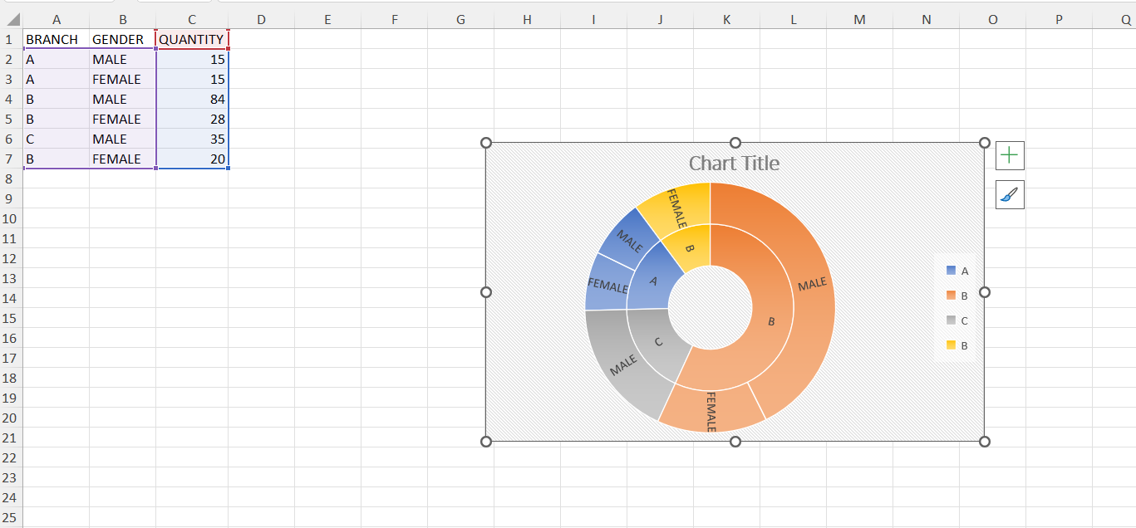
Sun burst

Slide 34
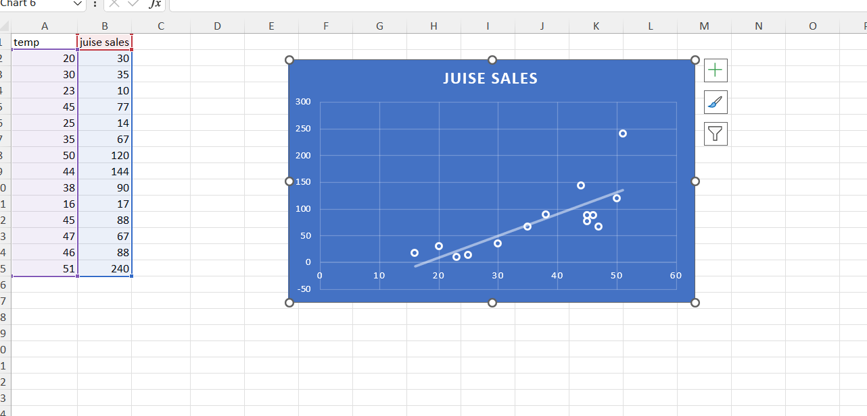
Scatter plot

Slide 35
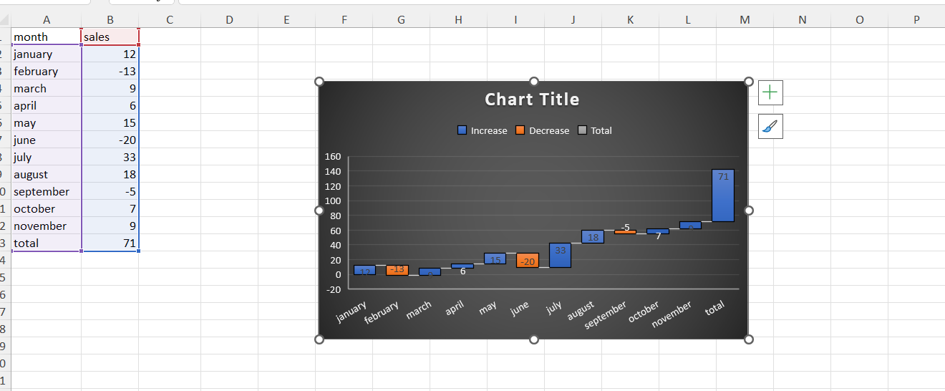
Waterfall chart

Slide 36
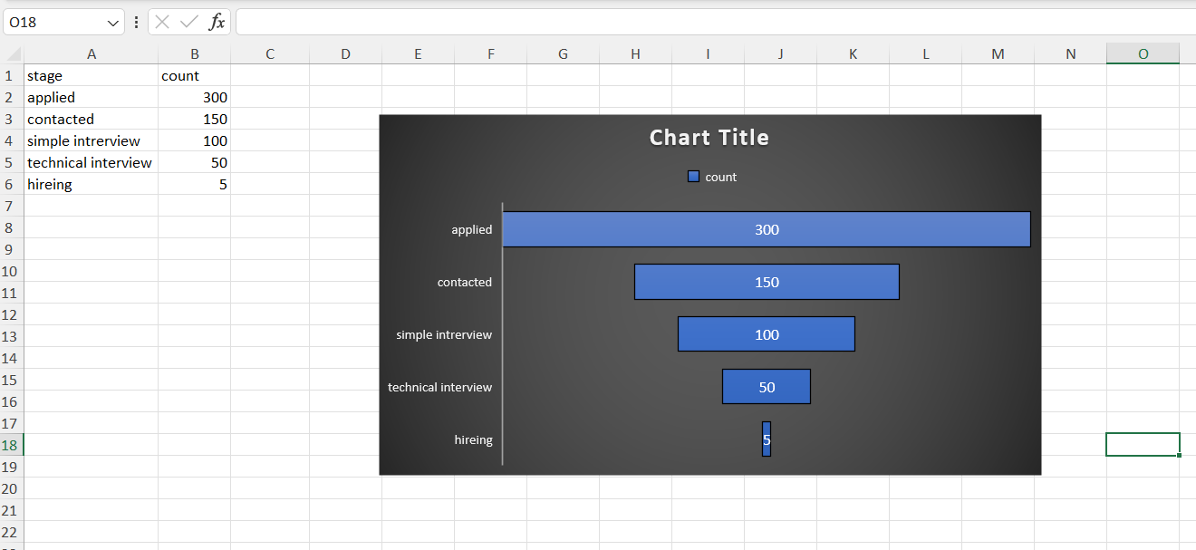
Funnel chart

Slide 37
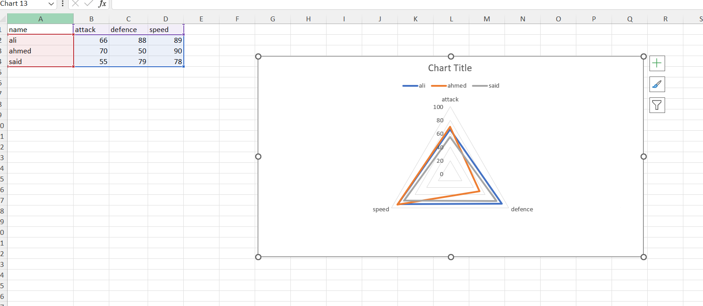
Radar chart

Slide 38
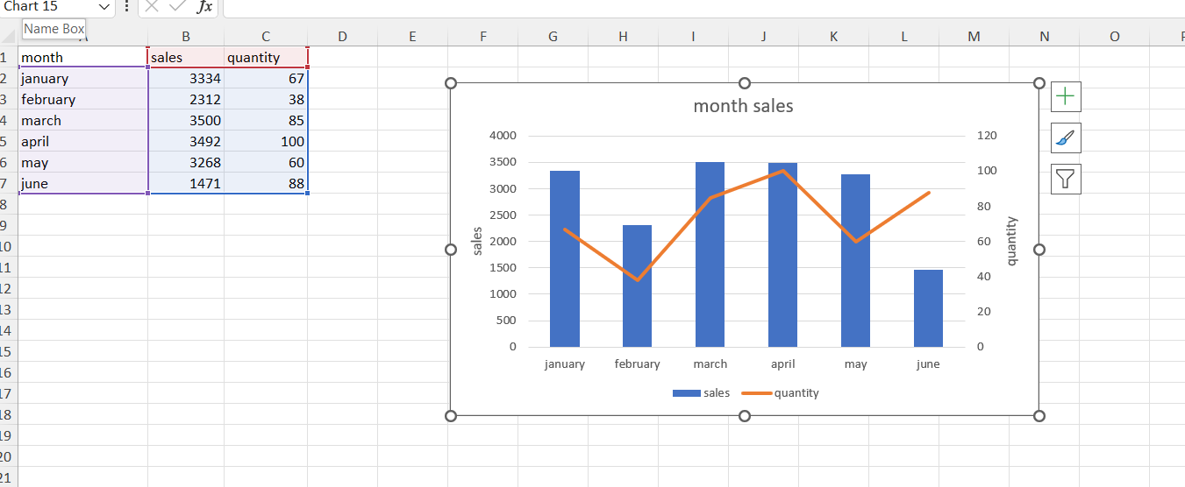
Combo chart

